Slide 1
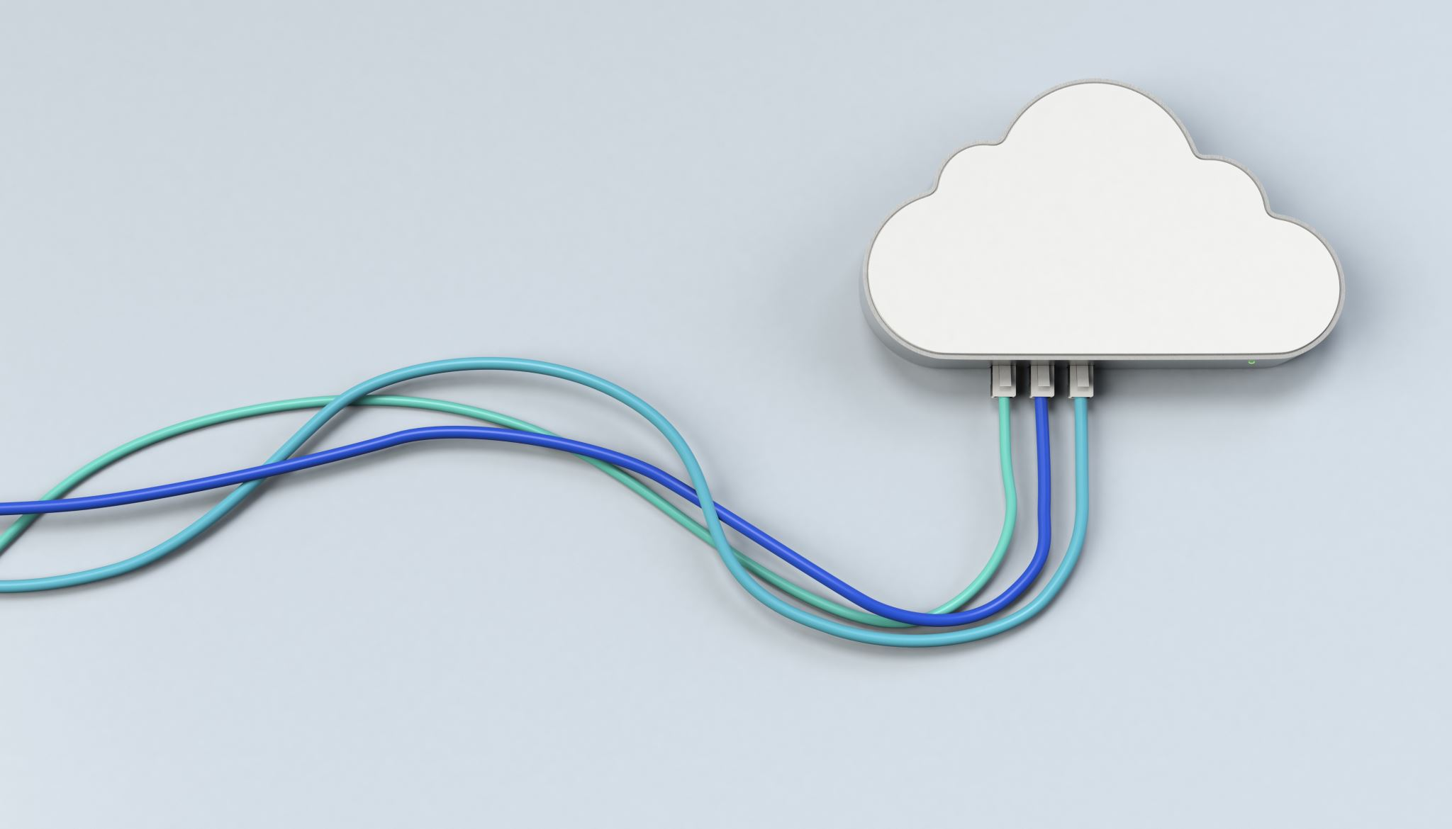
CHAPTER 7 Resource Virtualization
|Cloud Computing

Slide 2

Introduction to Virtualization
Key Concept: Virtualization is the process of simulating physical computing resources, allowing multiple virtual computers to run on a single set of physical resources.
Benefits: Optimizes resource utilization, enhances security, and provides abstraction.
Main Enabler: The hypervisor plays a critical role in creating and managing virtualized resources.
Example: A single physical processor can be virtualized to appear as multiple processors to the user.

Slide 3
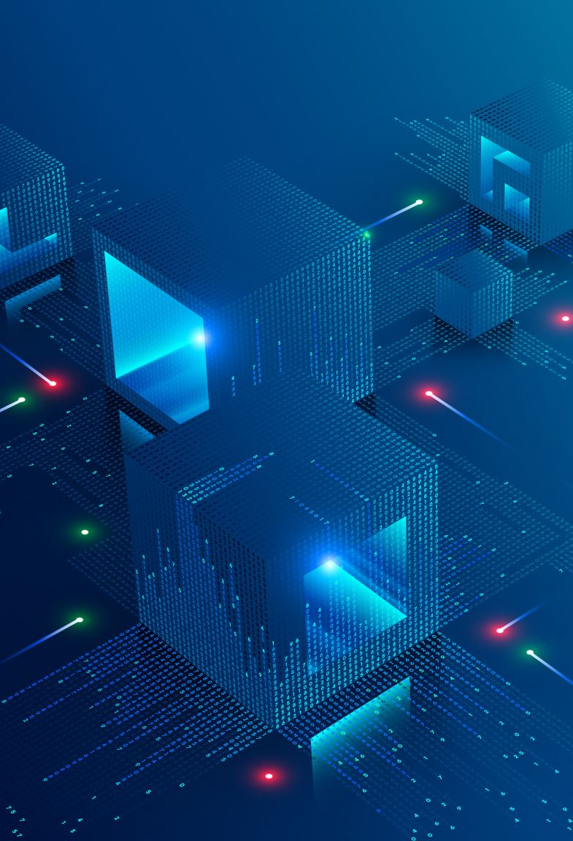
Virtualizing Physical Computing Resources
Resource Virtualization: Physical resources like CPU, memory, storage, and network devices can be virtualized.
Example: Virtual processors, memory, and storage are presented to users, abstracted from the underlying physical hardware.
Software Component: The control programs (software) create virtual machines (VMs), enabling the installation of guest operating systems.

Slide 4

Understanding Abstraction
Abstraction in Virtualization: The process of hiding the complexity of physical computing resources, presenting a simplified virtual resource to users.
Importance: This layer of abstraction makes cloud services more flexible and reliable.
Operating Systems: Guest operating systems are installed on virtual machines, functioning as though on physical hardware.

Slide 5
Machine or Server Level Virtualization
Definition: Server virtualization allows multiple operating systems (guest systems) to run on a single physical machine (host system).
Host vs. Guest: The host system runs the hypervisor, while guest systems are independent virtual machines running on the hypervisor.
Example: Different operating systems can run on the same physical server.

Slide 6
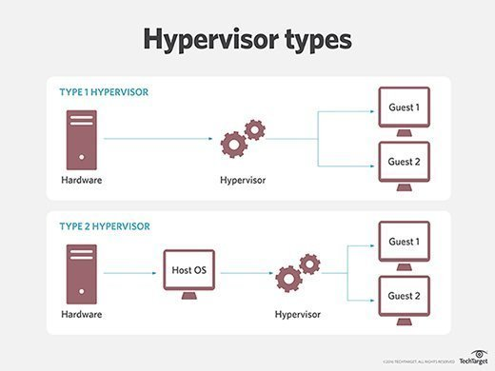
Hypervisor and Virtual Machine Monitor (VMM)
Hypervisor Role: Creates and manages the virtual environment, allowing multiple VMs to share physical resources.
Two Types of Hypervisors:
Type 1 (Bare Metal): Runs directly on the hardware.
Type 2 (Hosted): Runs on a host operating system.

Slide 7
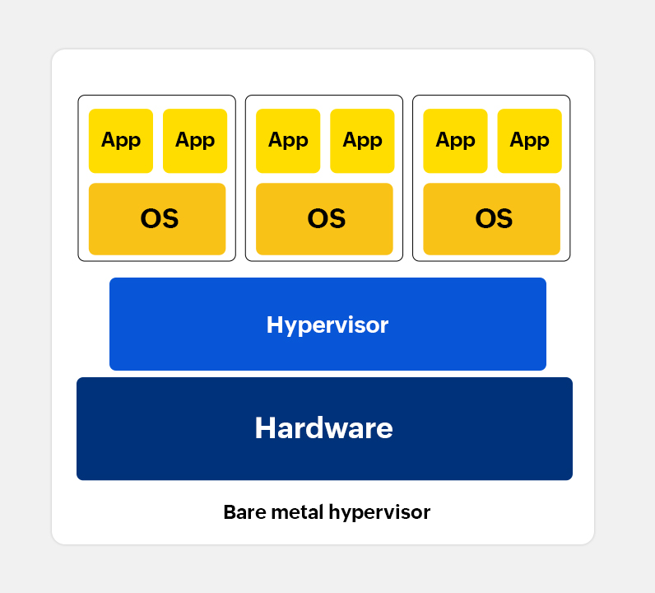
Bare Metal Approach (Type 1 Hypervisor)
Bare Metal Hypervisor: Directly installed on physical hardware, offering better performance and control.
Benefits: More suitable for enterprise-level applications and advanced resource management.
Examples: VMware ESXi, Microsoft Hyper-V, Xen.

Slide 8
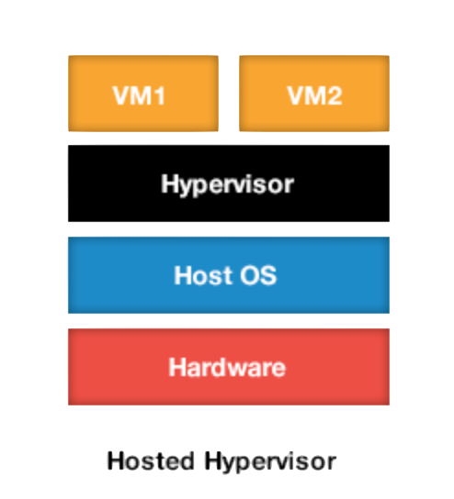
Hosted Approach (Type 2 Hypervisor)
Hosted Hypervisor: Installed on top of a host OS, making it easy to install and configure for various hardware platforms.
Drawbacks: Lack of direct access to hardware degrades VM performance. Not ideal for real-time OS support.
Examples: VMware Workstation, Microsoft Virtual PC.

Slide 9
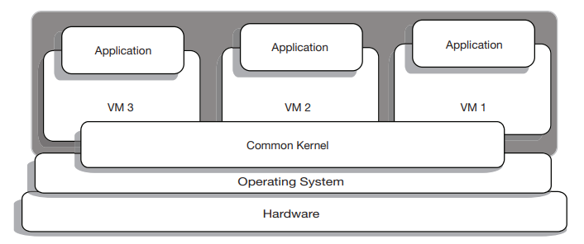
Operating System Level Virtualization
Definition: OS-level virtualization enables multiple user-space instances using a single OS kernel.
Key Point:
No hypervisor needed, shares the same kernel across virtual servers.
All virtual servers share the same kernel, so they consume fewer resources.
All virtual servers must use the same OS kernel.
Examples: FreeBSD’s Jail, Linux VServer, OpenVZ.

Slide 10
OS-Level Virtualization vs. Machine Virtualization
OS-Level: Same OS for all virtual servers, shared kernel.
Machine Virtualization: Allows different OS instances, uses hypervisor (e.g., VMware, Hyper-V).

Slide 11
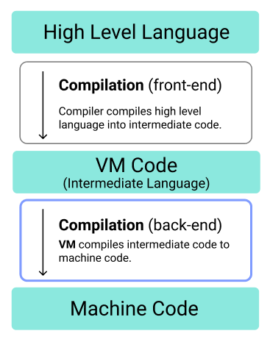
High-Level Language Virtual Machine (HLL VM)
Definition: A virtual machine that abstracts the instruction set architecture (ISA) and operating system, easing porting of compilers and applications across platforms.
Key Benefits:
Intermediate representation allows portability.
Abstract machine translates intermediate code to physical instructions.
Examples:
Java Virtual Machine (JVM)
Common Language Runtime (CLR) by Microsoft
Use Case: Allows Java and .NET applications to run on various platforms, decoupled from specific hardware.

Slide 12
Emulation
Definition: Emulation allows one system to mimic another, enabling software designed for one architecture to run on another.
Techniques:
Binary Translation: Converts binary code for one architecture to another.
Interpretation: Slower but easier, translating instructions as they are encountered.
Examples:
Microsoft VirtualPC
QEMU (Quick EMUlator)

Slide 13
Emulation vs. Simple Virtualization
Emulation:
Focus: Simulates hardware/software of a different architecture.
Requires instruction set translation.
Slower due to the need for binary translation.
Simple Virtualization:
Focus: Virtualizes the native environment with no instruction set translation.
Faster, near-native performance.
Example: Native virtual machines running Linux or Windows without translation.

Slide 14
Other Types of Virtualization
Network Virtualization:
Combines network resources into a single virtual network.
Examples: Virtual LAN (VLAN), Virtual Private Network (VPN).
Storage Virtualization:
Pools physical storage into virtualized storage systems.
Examples: SAN, Google Cloud Storage, Azure Storage.
Desktop Virtualization:
Separates applications from the desktop.
Example: VMware Fusion for running Windows on a Mac.

Slide 15
Advantages of Virtualization
Better Resource Utilization: Enables server consolidation and optimizes hardware usage.
Cost Reduction: Lowers hardware and infrastructure costs.
Improved Fault Tolerance: Virtual machines can be migrated in case of hardware failure.
Simplified System Administration: Easier management of resources and systems.
Legacy Support: Enables running outdated applications on modern platforms.

Slide 16
Downsides of Virtualization
Single Point of Failure: If the host system fails, multiple virtual machines may be affected.
Performance Overhead: Virtual machines may achieve 85-90% of the native performance.
Complexity: Troubleshooting and root cause analysis can be more difficult with an additional virtualization layer.

Slide 17
Virtualization Security Threats
Host Vulnerability: A breach at the physical host level affects all VMs.
Hypervisor Attacks: Compromising the hypervisor can jeopardize the entire environment.
Inactive VMs: Dormant VMs can pose a risk if they contain sensitive data but are not monitored.
Privilege Escalation: Attackers may gain higher access than allowed through the hypervisor.

Slide 18
Virtualization and Cloud Computing
Virtualization as a Foundation for Cloud Computing:
Virtualization technologies are integral to cloud computing, enabling cloud providers to optimize resource use.
It abstracts the physical infrastructure, allowing the cloud to offer flexible, scalable services.
Key Benefits in Cloud Computing:
Resource Efficiency: Maximizes hardware use through virtual machines.
Scalability: Easily scale up or down by adding or removing virtual machines.
Cost Savings: Cloud providers offer pay-as-you-go models, powered by virtualization.
Isolation & Security: Virtualization ensures isolated environments for different users.

